Slide 1
Access guard
D0969167 William Pan

Slide 2
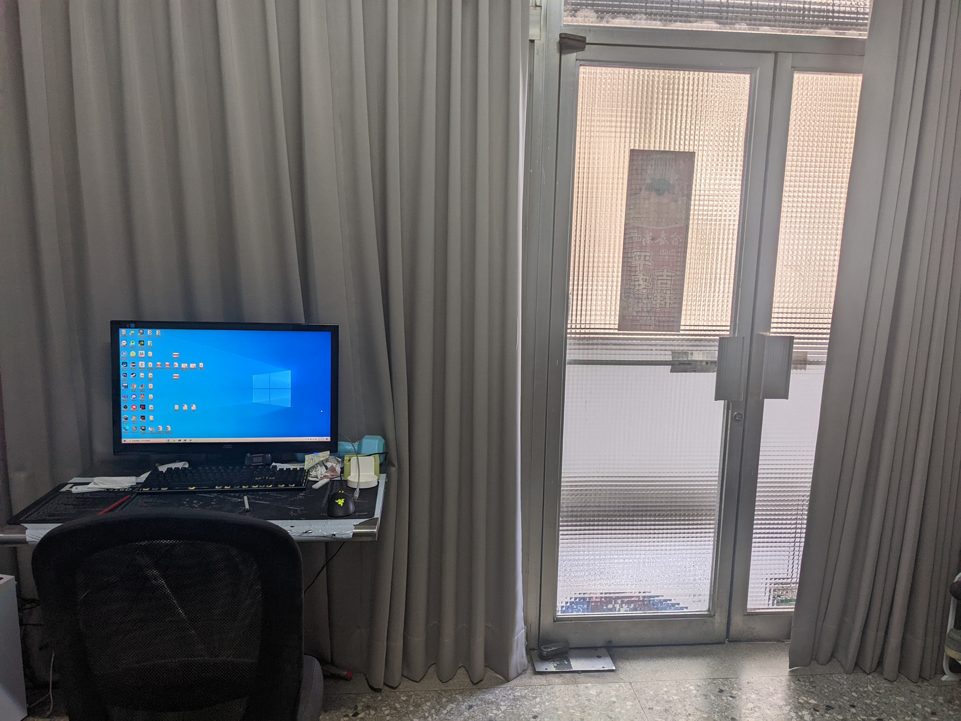
Motivation
While I stay at home during the pandemic , there are a lot of inconvenience in my room.

Slide 3
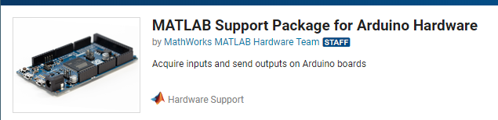
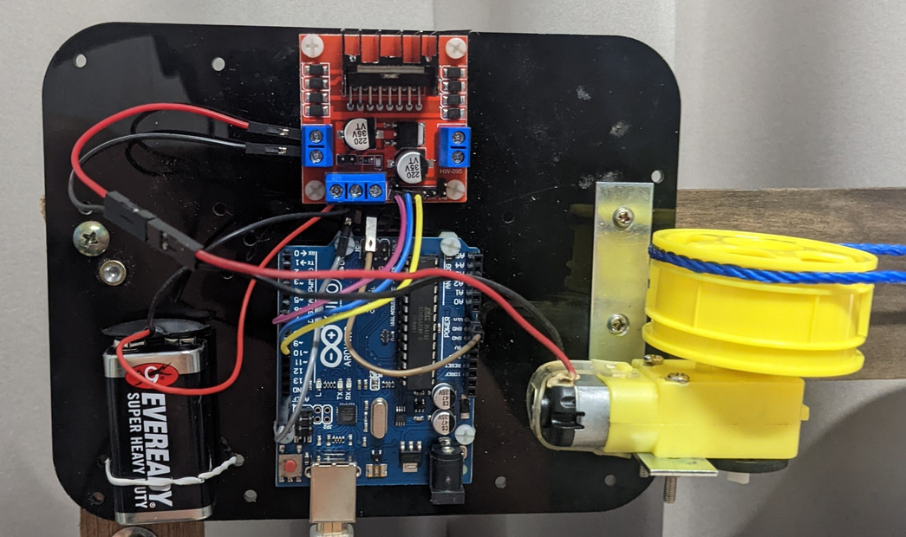
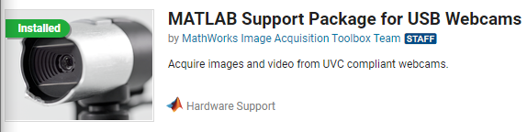
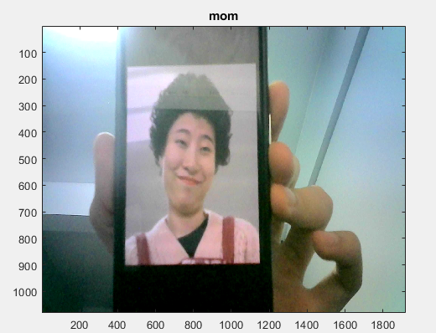
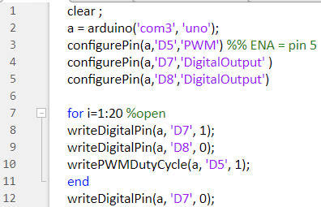
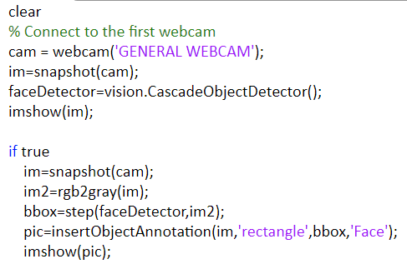
Proposed Method
arduino matlab
face detection
Access granted

Slide 4
Demonstration
https://youtu.be/s63793YxSP8

Slide 5
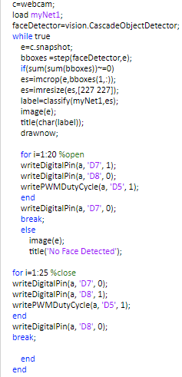
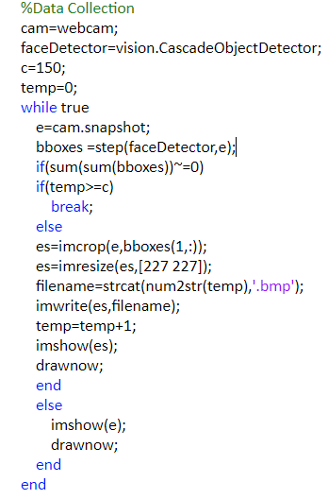
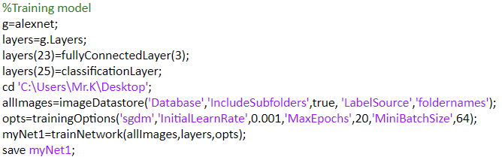
Code

Slide 6


Result

Slide 7
Conclusion
No manual needed
Quick access
convenience

Slide 8
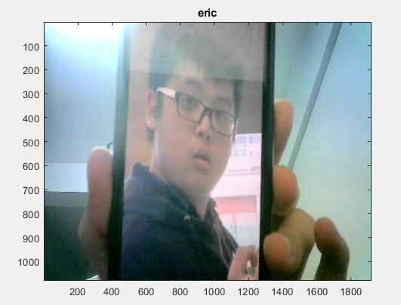
Future work
If you know who are in the list,then a photo could trick the camera
Easy to break

Slide 9
Reference
https://www.youtube.com/watch?v=MVRC6BFsaWI
https://www.mathworks.com/videos/using-usb-webcams-in-matlab-online-1563166929426.html
https://www.youtube.com/watch?v=OkHR1BZCcqA
https://www.youtube.com/watch?v=j0qeMMC1elM&t=352s
https://www.yiboard.com/thread-814-1-1.html

